Slide 1

Reward Capture Literature Review
Jonathan Yuquimpo

Slide 2
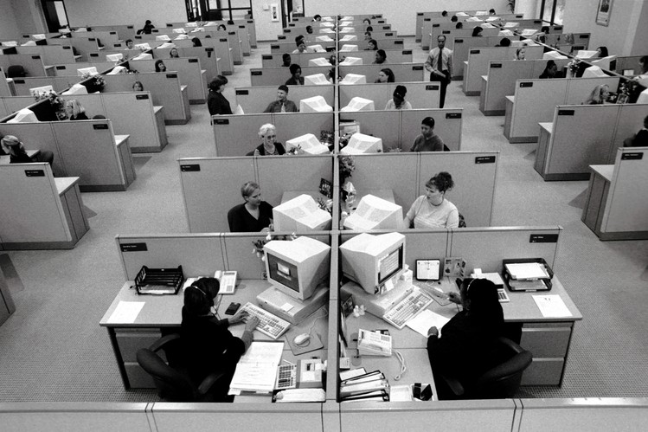
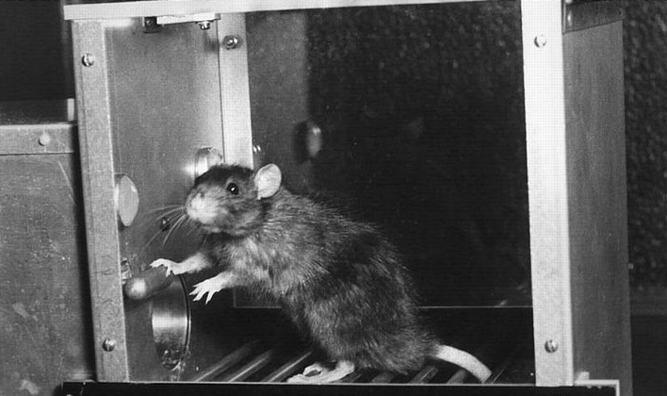

Slide 3
How reward impacts cognition
Reward
Selective Attention
Visual Working Memory

Slide 4
Top Down
Goal Driven
How reward impacts cognition
Value-Driven Attentional
Capture (VDAC)
Evidence VDAC may impact memory
1st year project!
Bottom Up
Stimulus Driven

Slide 5
How reward impacts cognition
Value-Driven Attentional
Capture (VDAC)
Evidence VDAC may impact memory
1st year project!

Slide 6
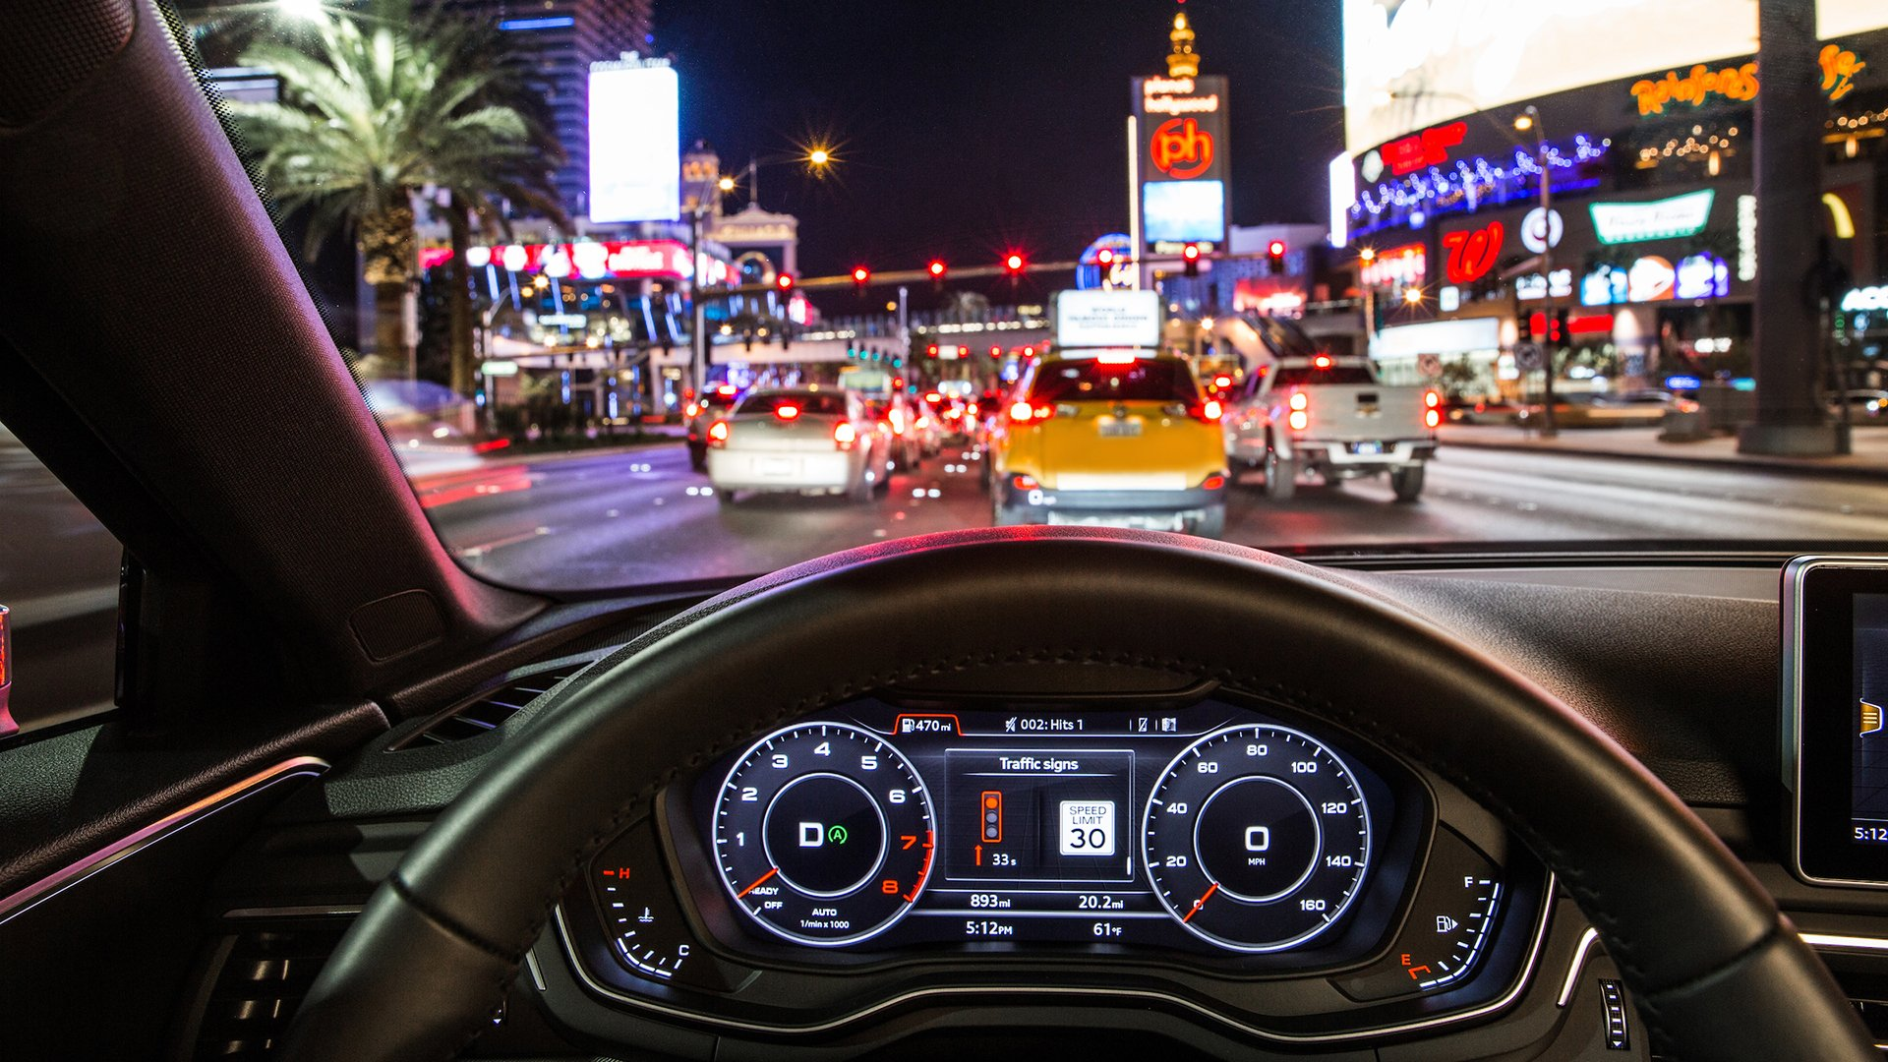

Slide 8
Top Down
Goal Driven
Selection History &
Reward
Bottom Up
Stimulus Driven

Slide 9
Top Down
Goal Driven
Selection History &
Reward
Bottom Up
Stimulus Driven

Slide 10
Selection History

Slide 11
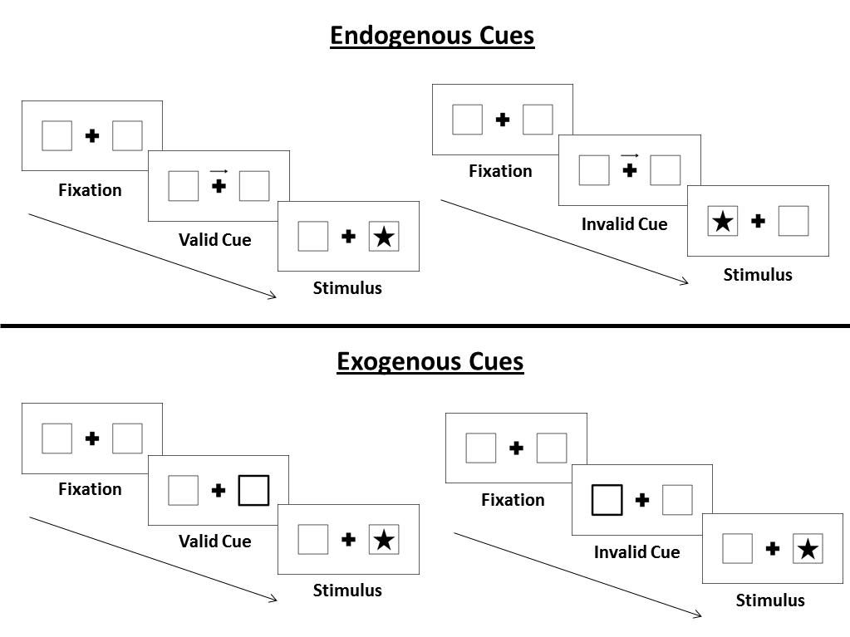
Posner, 1980

Slide 12
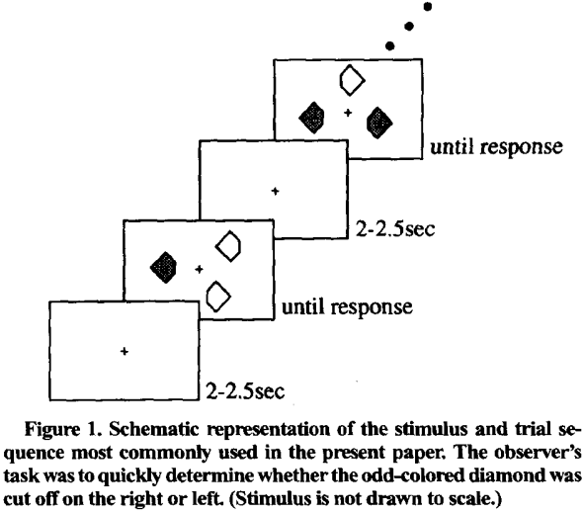
Examples of Selection History
Task: identify cut off (right or left) of odd-colored diamond
Pits stimulus expectancy vs priming by manipulating probability of color switch
P(switch) = 0: no switch – repetition effect
P(switch) = 1: always switching – completely predictable
P(switch) = .5: least predictable
Maljkovic & Nakayama, 1994

Slide 13
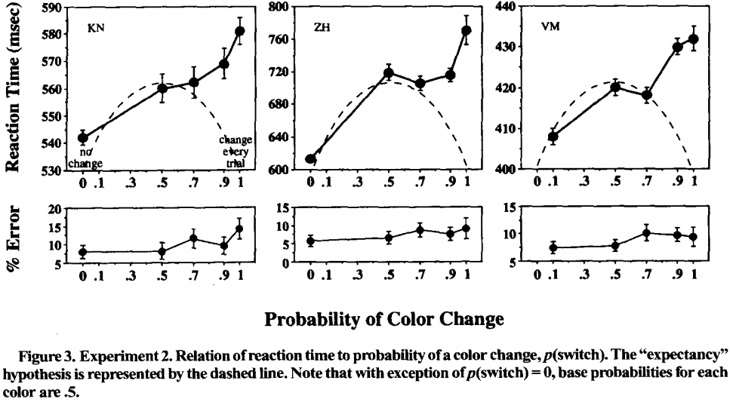

Slide 14

Learning Phase
Test Phase
+ $0.05
$10.05 total
1500 ms
Correct
1000 ms
1000 ms
1000 ms or until response
1500 ms or until response
400 – 600 ms
400 – 600 ms
Learned value magnifies salience-based attentional capture
Anderson et al., 2011

Slide 15
Learning Phase
Targets
+ $0.05
$10.05 total
Horizontal Target
Vertical Target
1500 ms
High Value Color:
80%: $0.05
20%: $0.01
Low Value Color:
20%: $0.05
80%: $0.01
1000 ms
1000 ms or until response
400 – 600 ms
Learned value magnifies salience-based attentional capture
Anderson et al., 2011

Slide 16
Test Phase
Targets
Horizontal Target
Vertical Target
Correct
High Value Distractors:
High Value Distractors:
1000 ms
1500 ms or until response
400 – 600 ms
Learned value magnifies salience-based attentional capture
Anderson et al., 2011

Slide 17
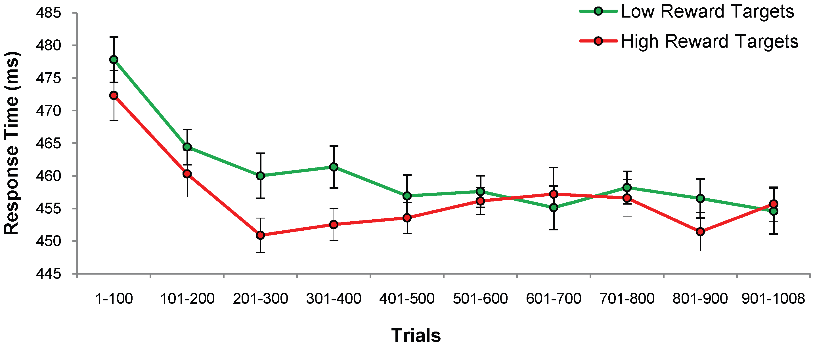
Training Phase: Lower RT for High Reward Targets
n = 18
Anderson et al., 2011

Slide 18
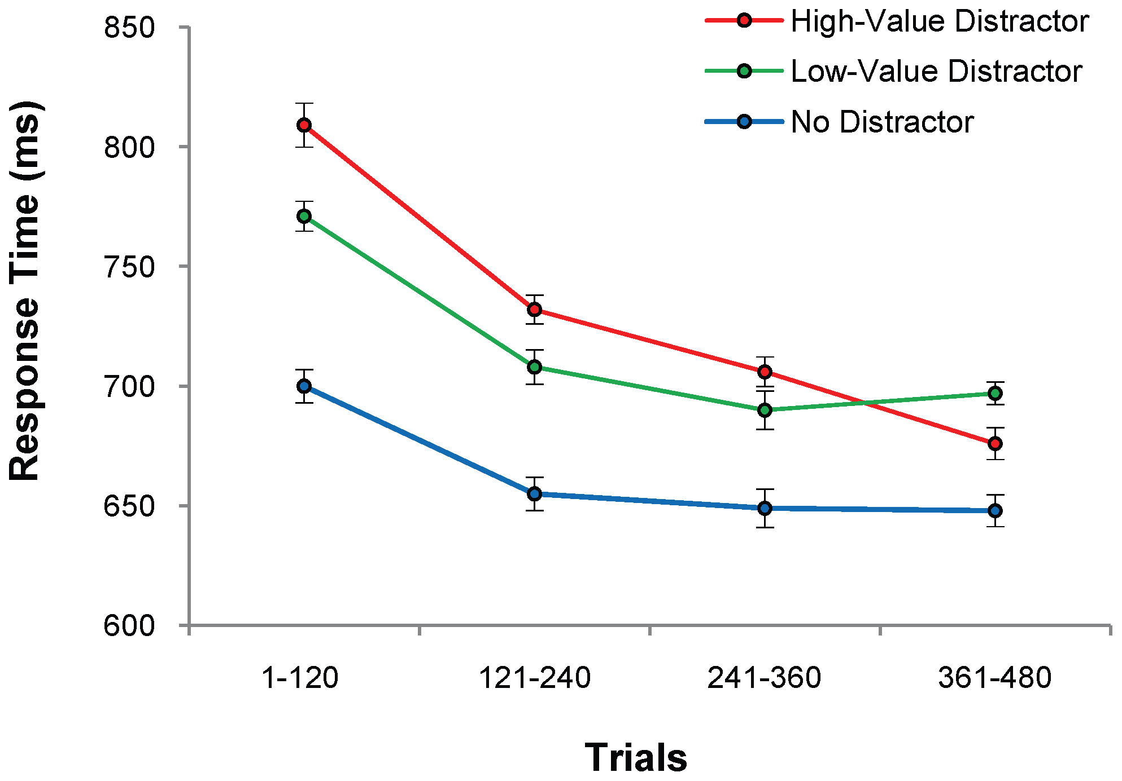
Test Phase: Higher RT for Previously Rewarded Distractors
High-Value: 728 (3.8)
Low-Value: 710 (3.9)
No Distractor: 655 (5.5)
n = 18
Anderson et al., 2011

Slide 19
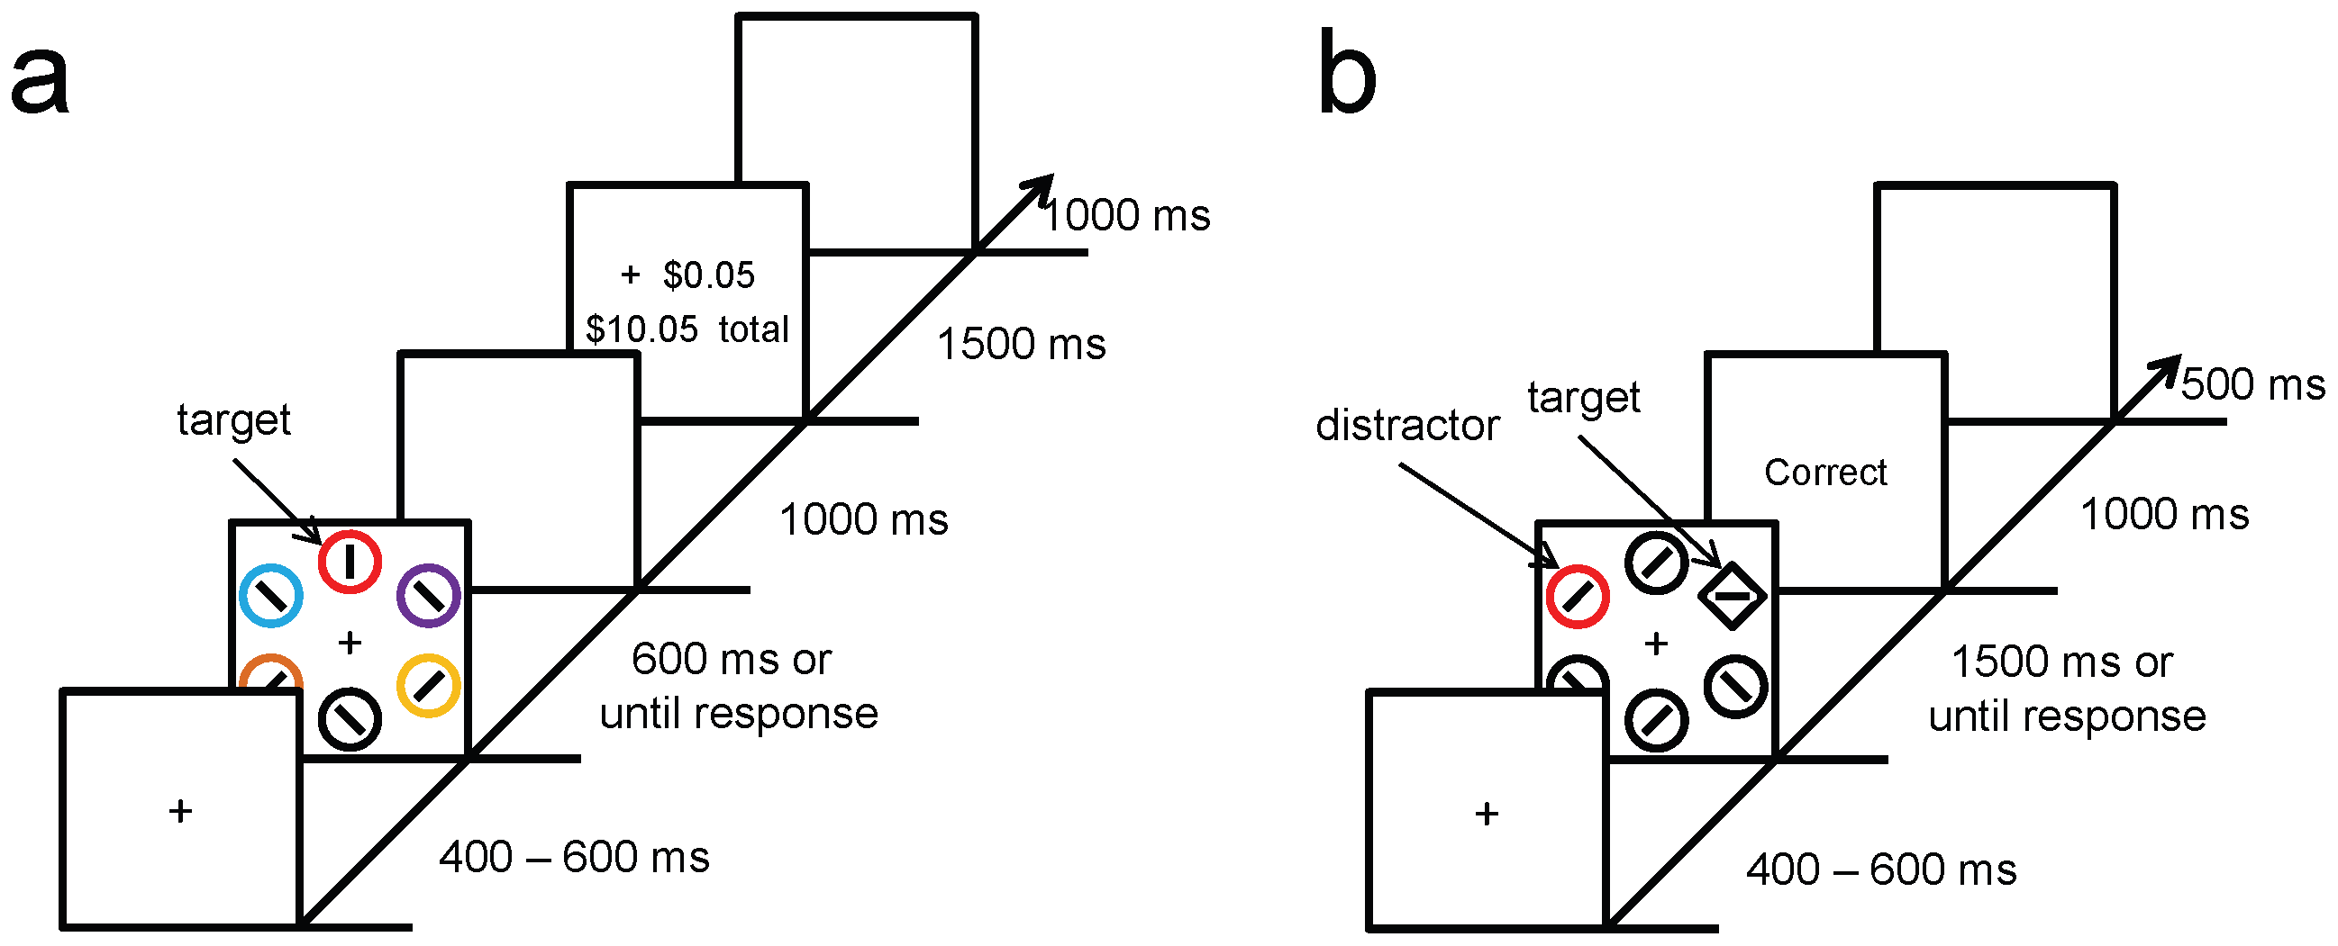
Experiment 2: Isolating Effects of Selection History (Reward =/= Selection History)
Red Targets
Green non-target
No reward feedback given
Compensation based on flat rate
Test phase was kept the same
Anderson et al., 2011

Slide 20
Targets:
Training Phase
Horizontal Target
Vertical Target
Target Distractor Color:
Non-target distractor color:
Test Phase
Anderson et al., 2011

Slide 21
Targets
Correct
Horizontal Target
Vertical Target
High Value Color:
Low Value Color
Correct
Anderson et al., 2011

Slide 22
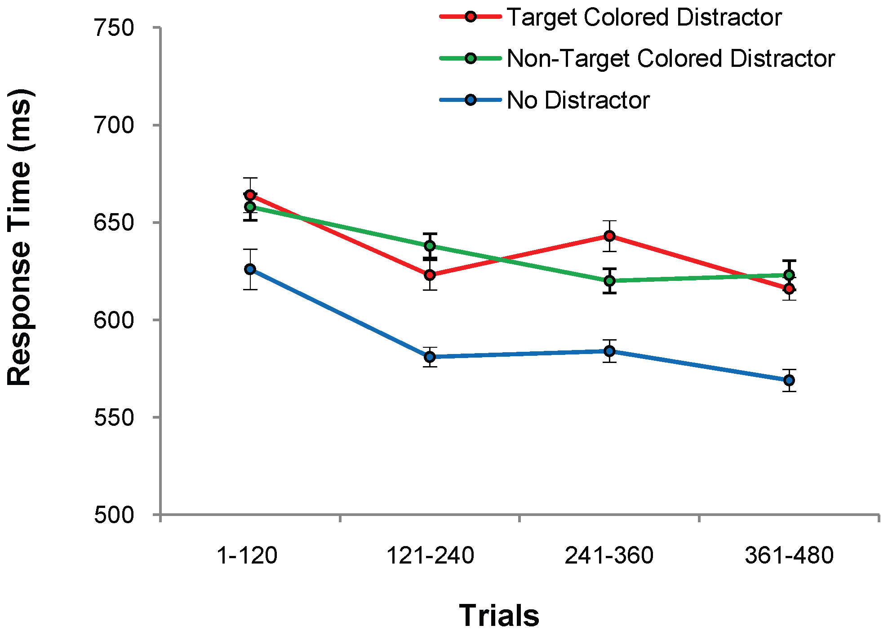
Test Phase 2: No Differences Between Distractor Conditions
Target: 634 (4.8)
Non-target: 632 (4.1)
No Distractor 588 (6.3)
n = 18
Anderson et al., 2011

Slide 23
Rewarded Distractors Resulted in Higher RT
Experiment 1:
Rewards
High Reward: 728 (3.8)
Low Reward: 710 (3.9)
No Distractor: 655 (5.5)
Shows effect of reward
Experiment 2:
Only Selection
Target Distractor: 634 (4.8)
Non-target Distractor: 632 (4.1)
No Distractor: 588 (3.6)
Shows effect of only selection history
Anderson et al., 2011

Slide 24
Summary so Far
Reward-associated stimulus features influence attentional capture independently of physical salience or prior selection history

Slide 25
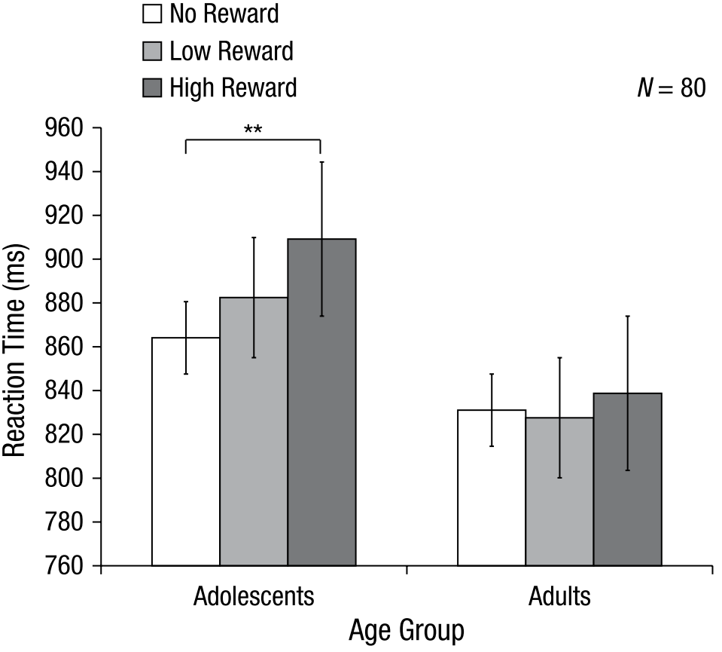
Additional Findings
Anderson, 2017
Mine & Saiki, 2015
Grégoire & Anderson, 2019
Roper et al., 2014

Slide 26
Reward leads to attentional capture
Reward
Selective Attention
Visual Working Memory

Slide 27
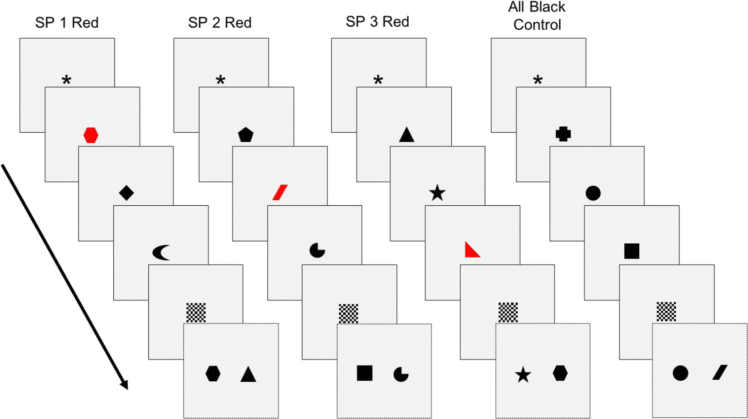
Recognition Task
Each item shown for 0.5s
Black = 3 pts
Red = 25 pts
High-reward vs. Equal-reward
Prioritization within visual working memory reflects a flexible focus of attention
Sandry & Ricker, 2020

Slide 28
Recognition Task
Directions
Characters
Խ Կ Ջ
Sandry & Ricker, 2020

Slide 29
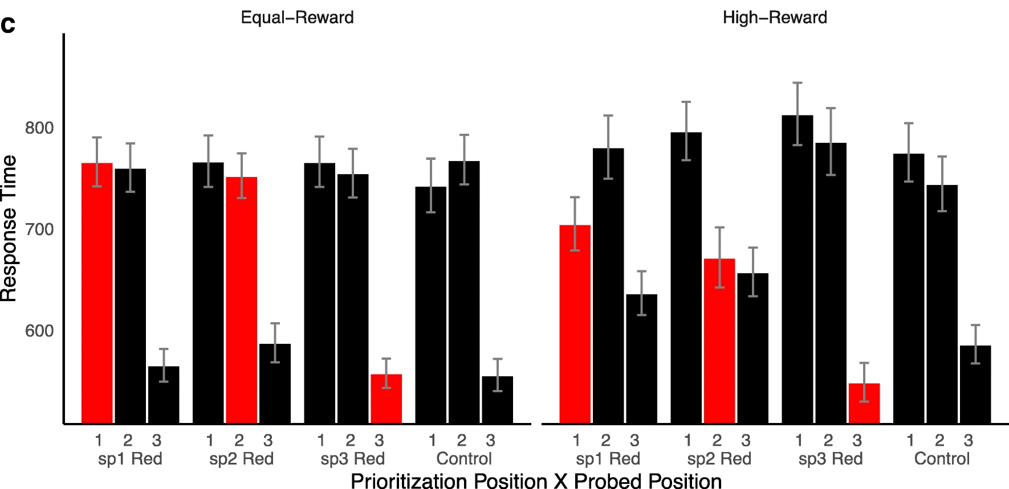
Description of Results

Slide 30
1st item
2nd item
3rd item
Test Item
--Mask--

Slide 31
1st item
2nd item
3rd item
Test Item
--Mask--

Slide 32
1st item
2nd item
3rd item
Test Item
--Mask--

Slide 33
1st item
2nd item
3rd item
Test Item
--Mask--

Slide 34
1st item
2nd item
3rd item
Test Item
--Mask--

Slide 35
1st item
2nd item
3rd item
Test Item
--Mask--

Slide 36
1st item
2nd item
3rd item
Test Item
--Mask--

Slide 37
1st item
2nd item
3rd item
Test Item
--Mask--

Slide 38
1st item
2nd item
3rd item
Test Item
--Mask--

Slide 39
1st item
2nd item
3rd item
Test Item
--Mask--

Slide 40
Effect of High-Reward on Response Time

Slide 41
Effect of High-Reward on Response Time

Slide 42
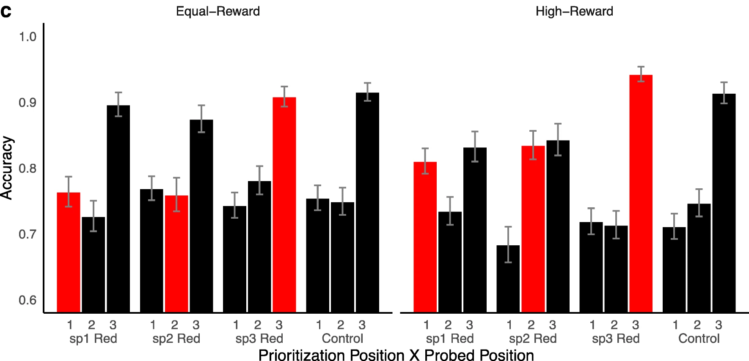
No Effect of High-Reward on Accuracy

Slide 43
Summary so Far
Reward-associated stimulus features influence attentional capture automatically and independently of physical salience or prior selection history
Attention can be flexibly allocated to maintain memory of rewarded stimuli with some resource trade-offs
Sandry & Ricker’s study does not show if the attentional effects of rewarded stimuli automatically transfer over to a memory task
The use of 2AFC prevents discriminability and criterion analyses

Slide 44

Learning Phase
Test Phase
A
2500 ms or until response
+ 10 points
42 points total
500 ms
1500 ms
D
500 ms
S
1000 ms
500 ms
1000 ms or until response
A
500 ms
400 – 600 ms
400 – 600 ms

Slide 45
Learning Phase
Green and red targets
200 trials (4 blocks of 50)
Money substituted with points
+ 10 points
42 points total
1500 ms
High Value Color:
80% 10 points
20% 2 points
Low Value Color:
20% 10 points
80% 2 points
1000 ms
1000 ms or until response
400 – 600 ms

Slide 46






List Item
Test Phase
Test Item
High Reward Color
N
A
2500 ms or until response
N
N
500 ms
D
500 ms
S
500 ms
A
500 ms
400 – 600 ms

Slide 47
200 Old/New trials
XX Old & XX New
Green (XX), Red (XX), & No Color Llists (xx0
No reward feedback
Test Phase
A
2500 ms or until response
500 ms
D
List Item
Test Item
500 ms
S
High Reward Color
500 ms
N
A
N
500 ms
N
400 – 600 ms

Slide 48



List Item
Test Phase
Test Item
High Reward Color
N
A
2500 ms or until response
N
N
500 ms
D
Low Reward Color
N
500 ms
S
N
500 ms
A
N
500 ms
No Color
N
400 – 600 ms

Slide 49
Hypotheses
Effect of…
Reward Condition
Trial Block
Interaction

Slide 50
Learning Phase
67 online participants
1 excluded due to technical problems
2 due to failing attention checks
+ 10 points
42 points total
1500 ms
High Value Color:
80% 10 points
20% 2 points
Low Value Color:
20% 10 points
80% 2 points
1000 ms
1000 ms or until response
400 – 600 ms

Slide 51
Learning Phase

Slide 52
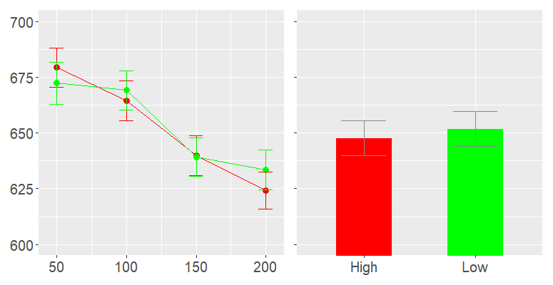


Mean Response Time by Trial Block and Reward Condition
By Trial Block
By Reward Condition
Effect of…
Reward Condition
Trial Block
Interaction
Response Time
Trials
Reward
n = 62, error bars represent standard error.

Slide 53
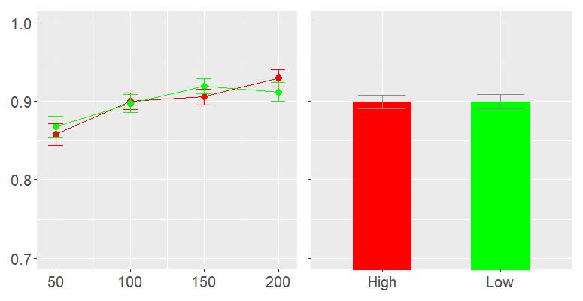
Mean Accuracy by Trial Block and Reward Condition 775 x 400
By Trial Block
By Reward Condition
Effect of…
Reward Condition
Trial Block
Interaction
Proportion Correct
Trials
Reward
n = 62, error bars represent standard error.

Slide 54
Test Phase

Slide 55
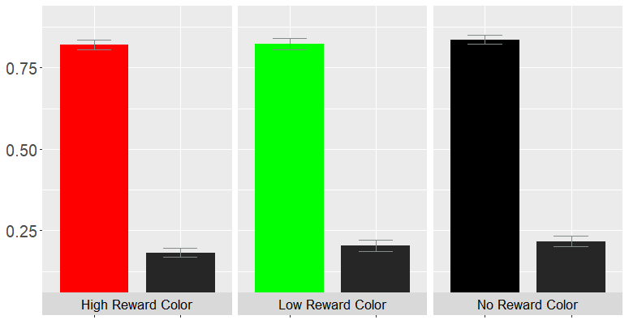
Hit Rate (HR) and False Alarm Rate (FAR) by Reward Condition
Reward
High
Low
None
Effect of Reward on…
Hit Rate
False Alarm Rate
Proportion
HR
FAR
HR
FAR
HR
Trial Block

Slide 56
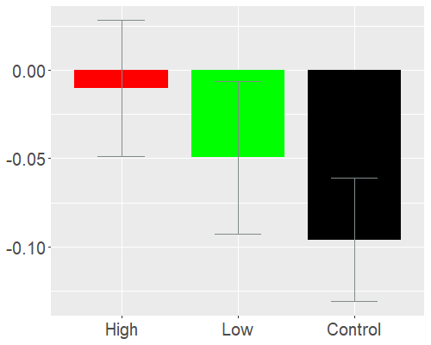
dprime by Reward Condition
Effect of Reward on…
Discriminability
Criterion
d-prime (d’)

Slide 57
dprime and Criterion by Reward Condition
Effect of Reward on…
Discriminability
Criterion
Criterion (c)

Slide 58
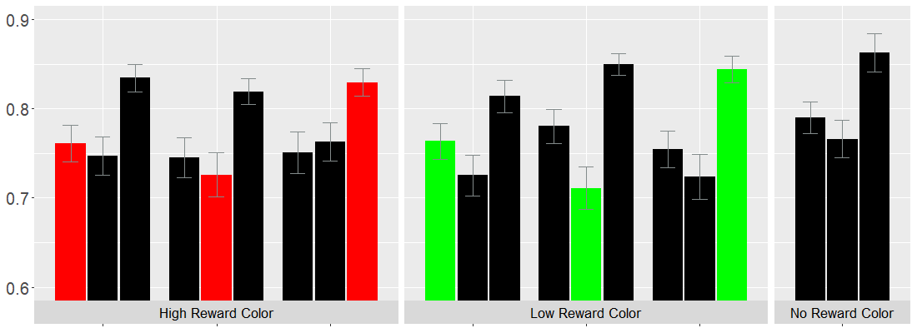
Hit Rate by Reward Condition and Target Position
n = 62, error bars represent standard error.
Color Values: High Low None

Slide 59
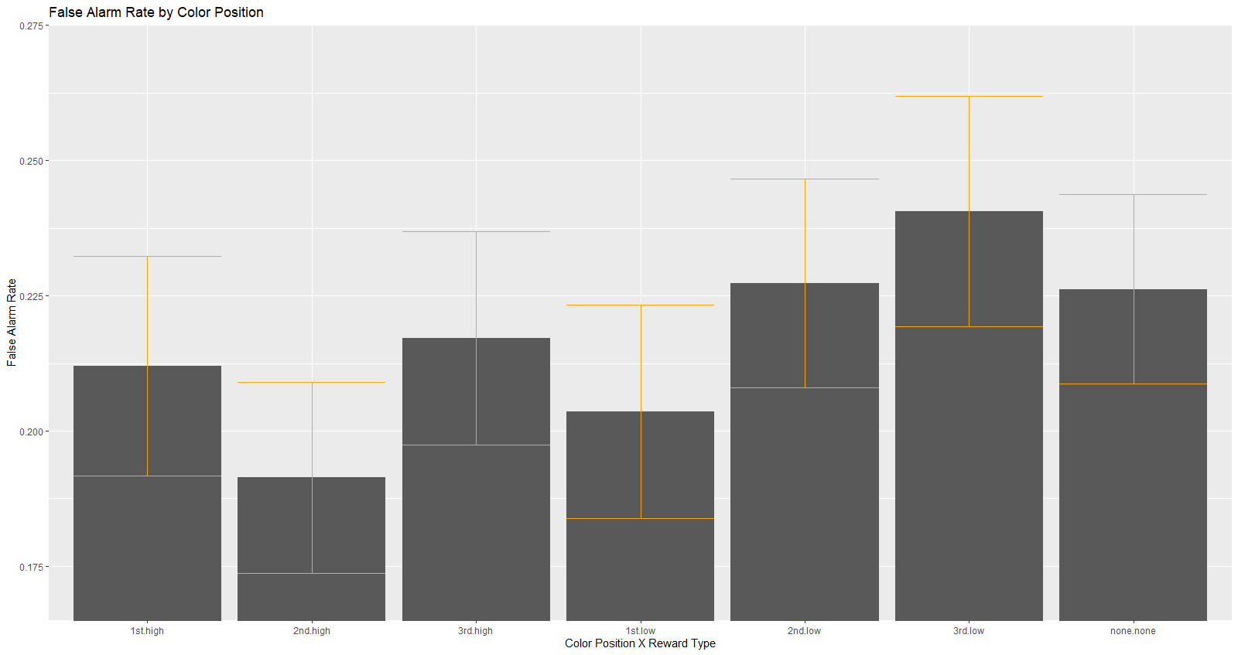
False Alarm Color x Position

Slide 60
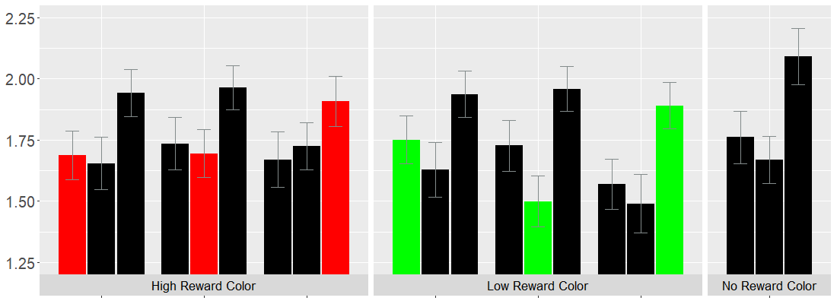
dPrime by Reward Condition and Target Position

Slide 61
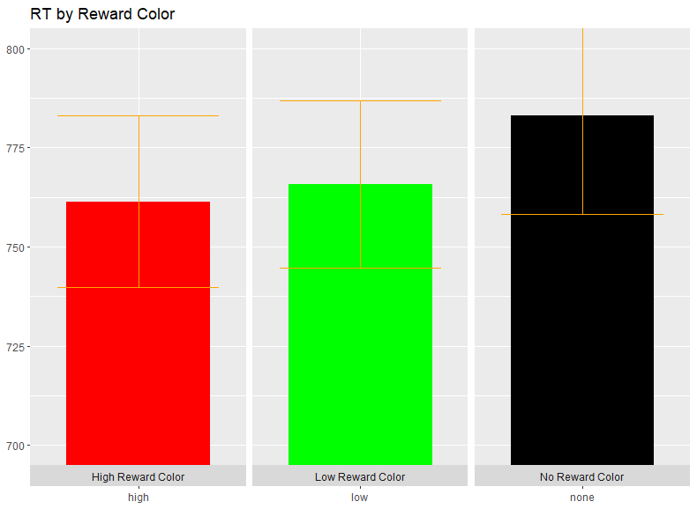
Response Time Color

Slide 62
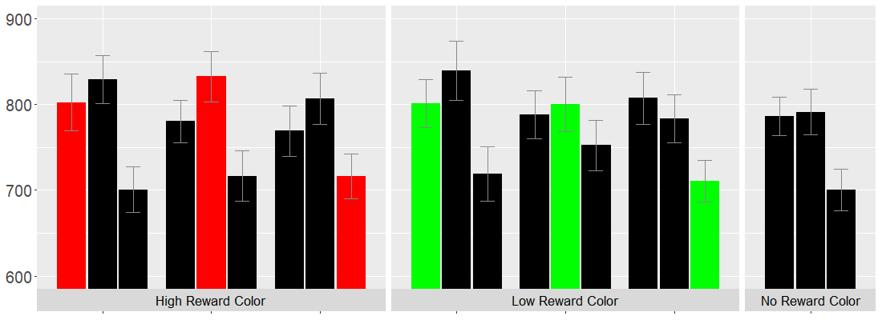
Response Time by Reward Condition and Target Position

